Slide 1
Before the session
There will be code along during this session. I will be using Python, NumPy, and Pandas. If you want to code with me, please install them (if you don’t have them). But you don’t need to code if you don’t want to.
All the code will be available at:

Slide 2
Linear Regression and a Method for Creating a ML Algorithm from Scratch

Slide 3
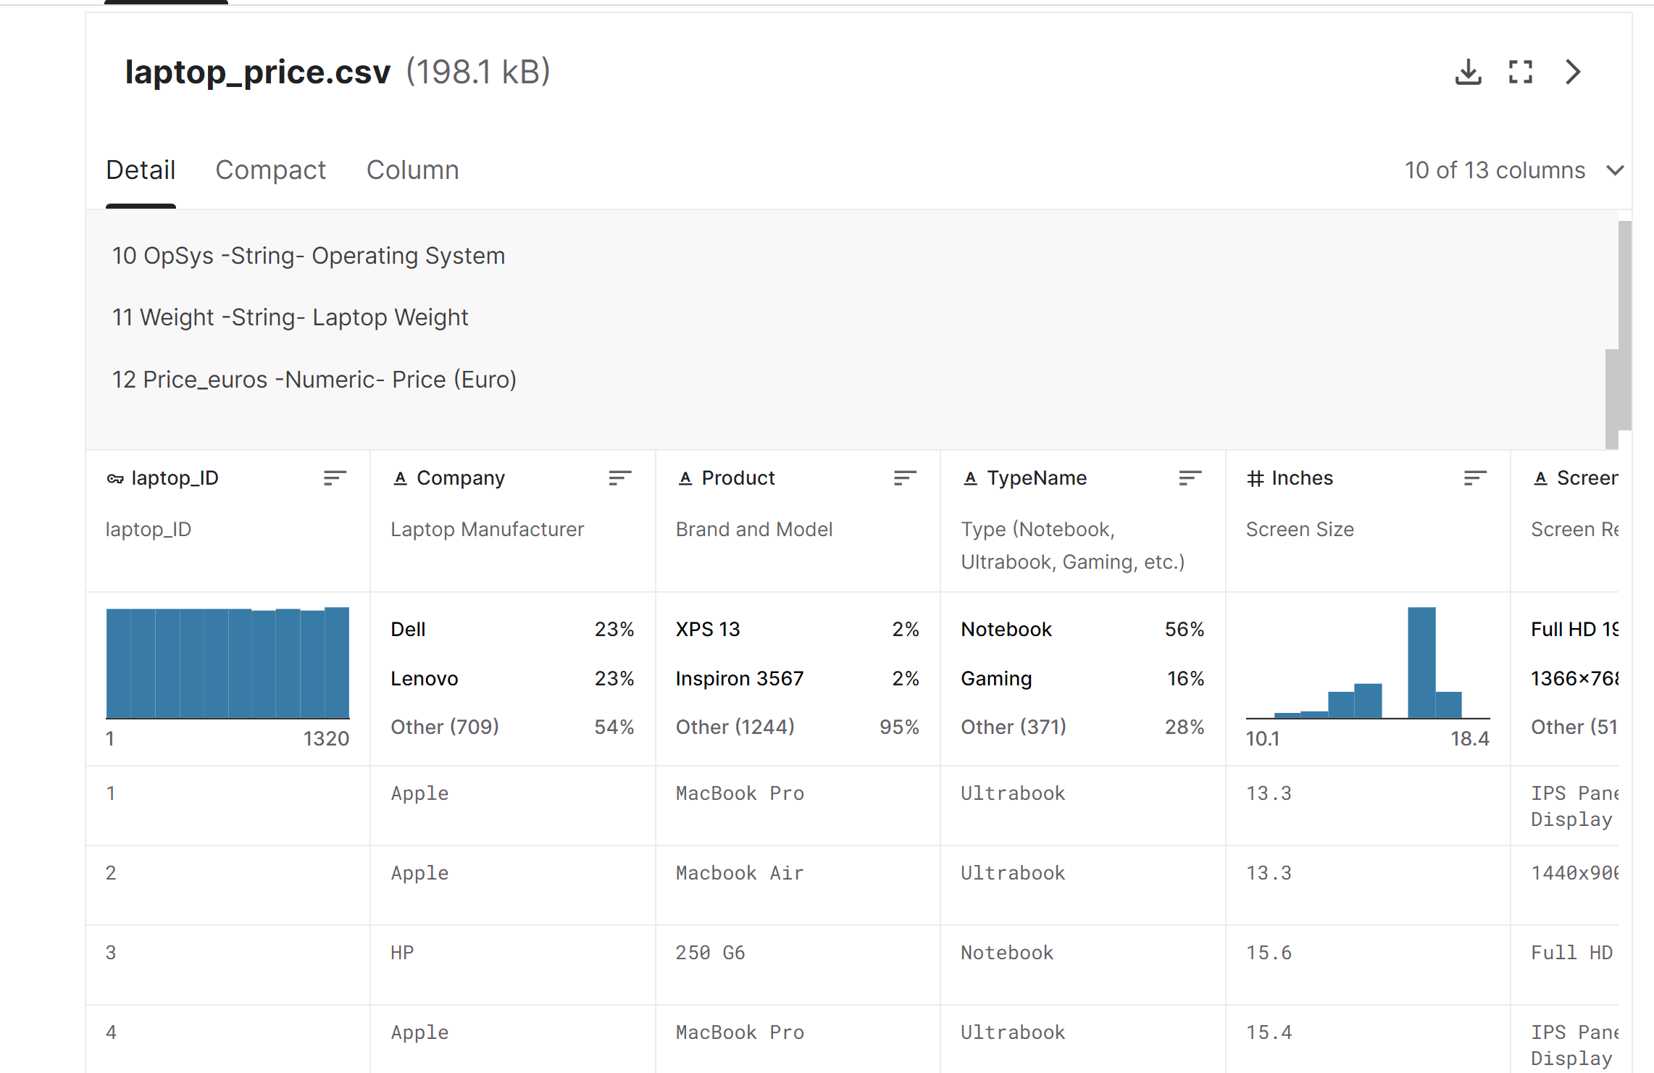
Let’s say we want to predict laptop price…
https://www.kaggle.com/datasets/muhammetvarl/laptop-price

Slide 4
We can use LinearRegression from scikit-learn

Slide 5
But pretend that you don’t know anything about libraries or even ML concepts; How will you predict laptop price?
We have data from the past – that (probably) shows the relationship between the computer power and the price.
We want to somehow use this data
IDEA: If we can determine the relationship between x and y from this past data, such as:
y is small when x is big
y is twice as big as x
y increases rapidly when x is bigger
when another x is found, the relationship can inform the corresponding value of y.

Slide 6
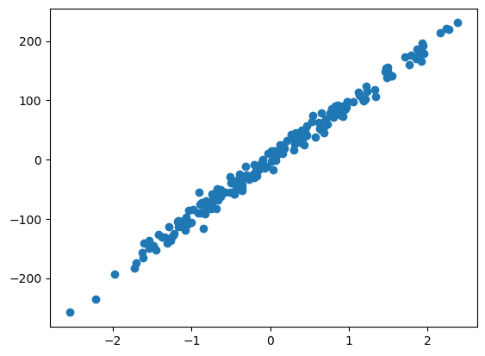
And that’s exactly what ML is trying to do
Predict Model
Given CPU power = 1.2, we can predict that the laptop price is 110 (Euro).
Fit a Model

Slide 7
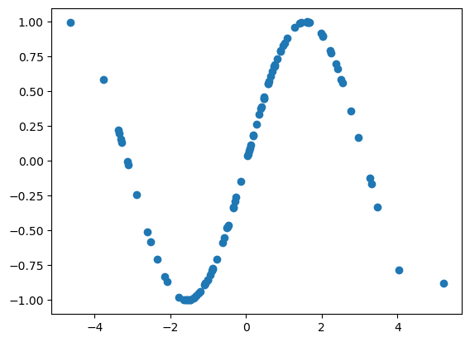
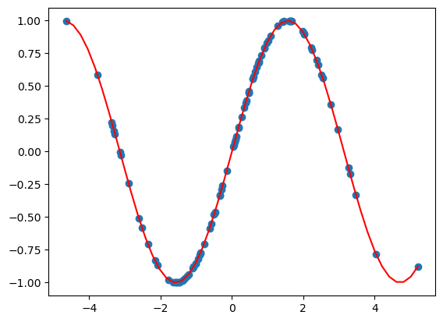
Same with more complex algorithms, but they can fit to more complex data
Models (red line/curve) fit to the data points (blue dots)
Decision Tree
Neural Network
We are trying to achieve a function (a line/curve, etc) that best describe of the true relationship between features (predictors) and a label (target).

Slide 8
But then how do these algorithms work? How do these algorithms use the past data to make a model and predict?
Today, I want to go through the process of “creating” a machine learning algorithm, using linear regression as an example.
To simplify things, we will first only use the “CPU” column as a feature and laptop_price as the target. i.e. We will be going through Simple Linear Regression (SLR).
Later, if we have time, we will use all columns to predict the laptop_price.

Slide 9
Code Along: Let’s import & pre-process the laptop data

Slide 10
General Steps to create a ML algorithm
Prepare a Base Model
Define Cost(Objective) Function
Solve Mathematical Optimization Problem
Implement it

Slide 11
Model Preparation

Slide 12

Question: what ML algorithms do you know? Can you rank them in order of complexity?
Image from scikit-learn

Slide 13
Pick a Base Model with Suitable Complexity
For today, we choose a line as a model for simplicity
One Line (e.g. linear regression)
One Polynomials/Custom Function (e.g. polynomial regression)
Many lines, parallel to axes (e.g. decision tree)
Many lines/polynomials (e.g. neural network)
Complex
More likely to overfit = high variance
Simple
More likely to underfit = high bias
Suitable for simpler tabular data
Suitable for complex tabular data
Suitable for complex data (e.g. image/audio)

Slide 14
Defining Cost Function

Slide 15
What is Loss Function? Why we need it?
We ASSUME that the data points represent the TRUE relationship between X and y
We want our model (i.e. a line or any other functions) to represent the TRUTH.
Even with a line, there are varieties of them → Visually, we might be able to tell that some of them represents the true relationship better
However, we need a number that objectively and technically ranks each line to find the best line
→ Need for Loss function

Slide 16
Example
We assume that the data points (blue dots) represent the TRUE relationship between CPU and laptop price
Laptop Price
There are infinitely many lines…
Some of them seems to be representing the true relationship better (i.e. a better fit & model)
CPU

Slide 17
Loss Function 1
L(parameters of a model)
E.g. if you choose a line, gradient a and y-intercept b will be the parameters; Only they decide the shape of the model
Sums of residual

Slide 18
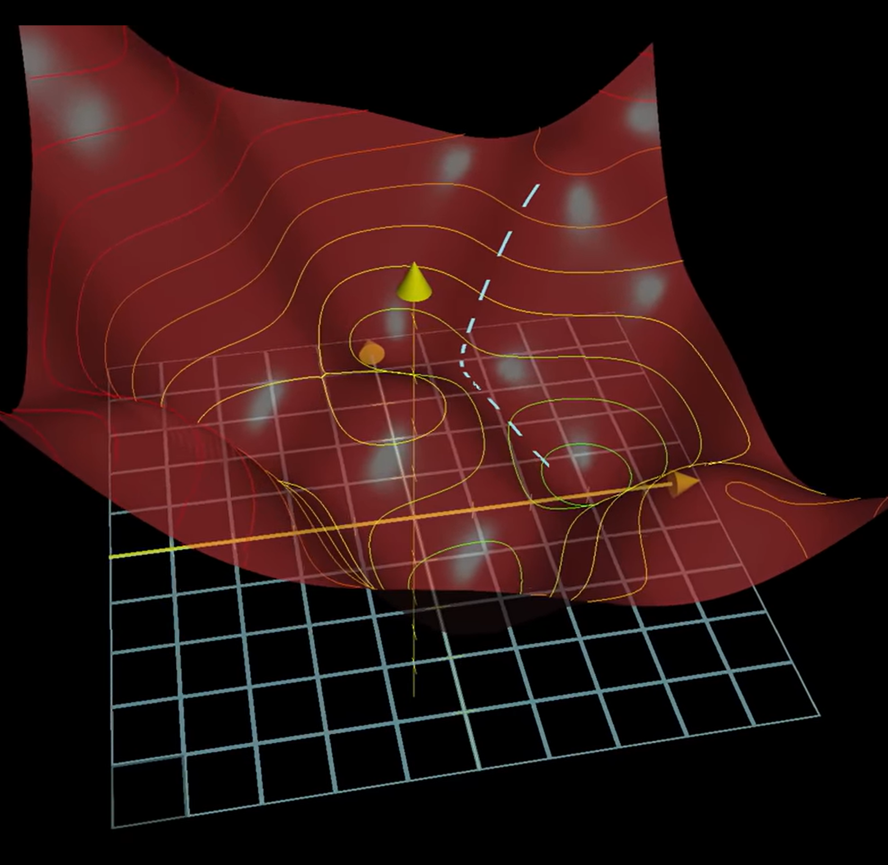
Loss Function Visualization
Two parameters
x-axis: w_0
y-axis: w_1
z-axis: f(w_0, w_1)

Slide 19
Question: which function(s) can be used as a loss function?
f(x) = x^2
f(x) = x^3
f(x) = log(x)
f(x) = ||x||

Slide 20
Choices of Loss functions
For Regression
Mean squared error
Mean absolute error
For classification
Logarithmic loss (used in logistic regression)
Cross entropy (used in neural network)

Slide 21

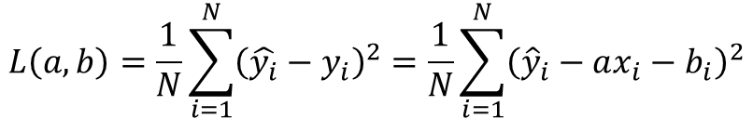
Loss Function for SLR
We usually use mean squared error for linear regression
$$L\left(a, b\right)=\frac{1}{N}\sum_{i=1}^{N}{{\left(\hat{y_{i}}−y_{i}\right)}^{2}}=\frac{1}{N}\sum_{i=1}^{N}{{\left({\hat{y}}_{i}−ax_{i}−b_{i}\right)}^{2}}$$
Our task is to minimize this function. Formally:
$$\underset{a, b}{argmin}{\frac{1}{N}\sum_{i=1}^{N}{{\left({\hat{y}}_{i}−ax_{i}−b_{i}\right)}^{2}}}$$

Slide 22
Mathematical Optimization

Slide 23
How do we minimize the loss function?
There is a mathematical branch called Mathematical Optimization, which is a dedicated field in optimizing different types of functions.
Most ML algorithms benefit from the knowledge of this branch.

Slide 24
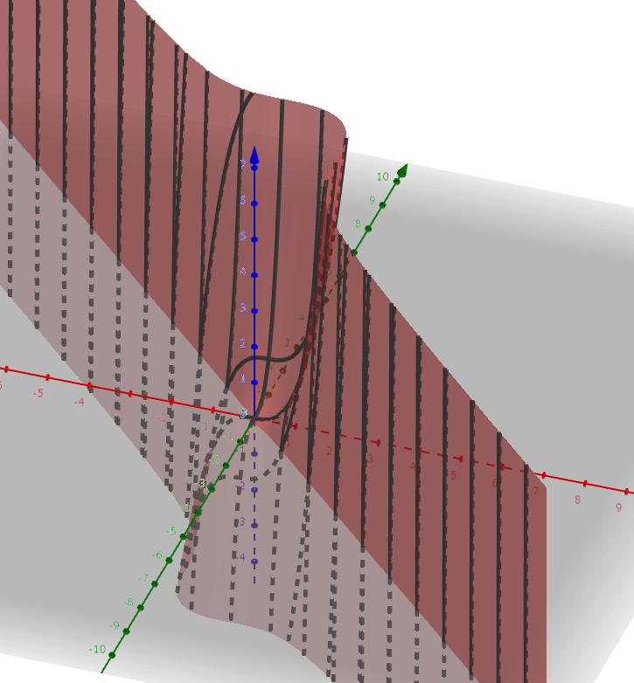
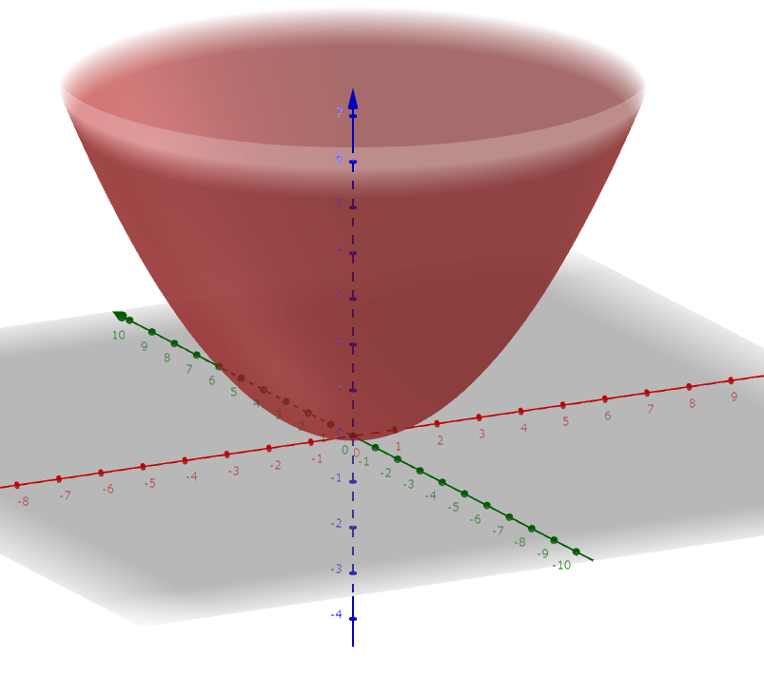
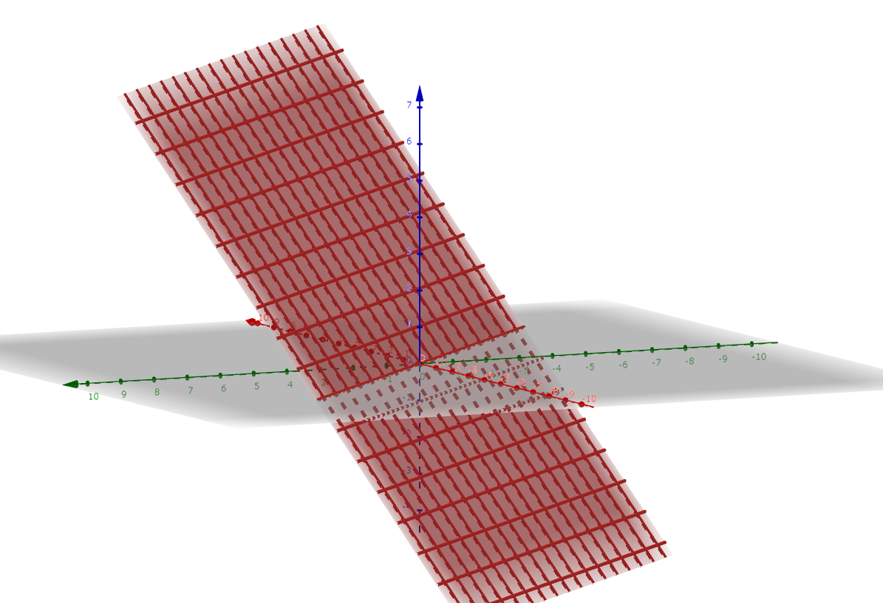
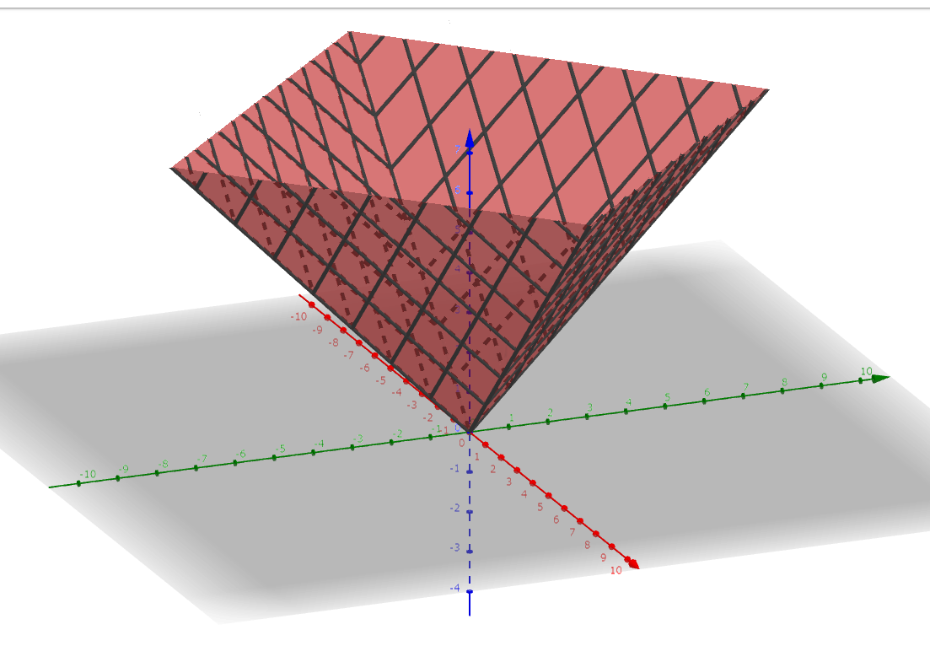
Question: What do you think the shape of a loss function look like?
1)
2)
3)
4)

Slide 25
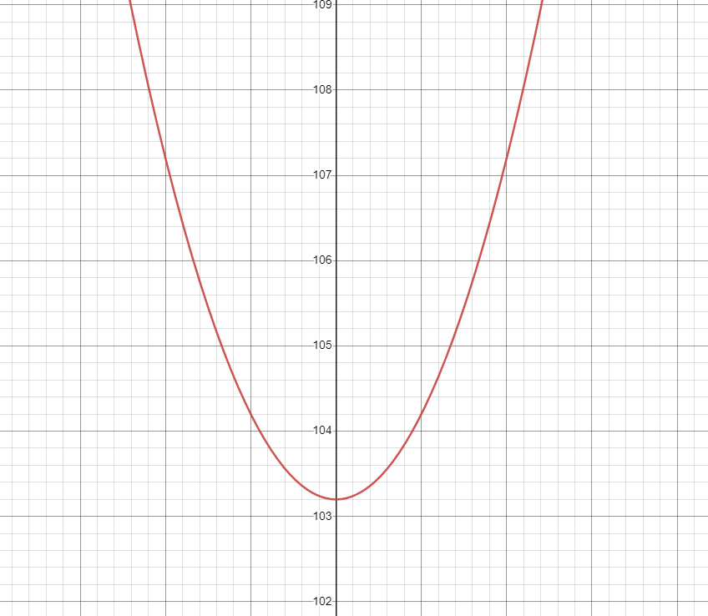
The answer is 1 or 4 because…
1)This line leads to a big loss because weight is too big
3)This line represents the relationship the best
loss
2)Bigger loss due to too big weight
1)Bigger loss due to too small weight (from optimum one)
Laptop Price
2)This line leads to a big loss because weight is too small
Value of a parameter (e.g. weight)
3)The smallest loss when a line represents the true data the best
CPU
Appropriately designed loss function should be a convex (concave up) function.
Notes:
The answer is 1 and 4. When we fit a line to a data using an appropriate loss function, there are usually three cases in terms of the value of loss function:
1) large value of loss function (which is unwanted) because weights are too big compared to optimum one,
2) large residuals because weights are too small compared to optimum one,
3) the smallest residual because the weights represent the true data the best.
The nature of the problem implies that a function should look like a cone where loss can be big in two ways and there is only one global minimum between them.

Slide 26
Different Optimization Types/Techniques
Mathematical optimization
Convex optimization
…
Analytical
Iterative
Gradient descent
Newton’s method
…
Momentum
Adagrad
…
But since it doesn’t take much time, we will implement this one too
Normal differentiation
A branch in mathematics
We are going to focus on this one today because it’s versatile and used everywhere

Slide 27
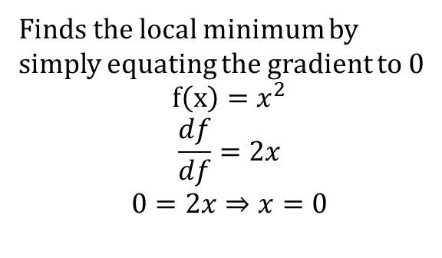

Analytical vs. Iterative
Analytical
Iterative
$$x_{i+1} =x_{i} −α∙2x$$
Getting closer to the local minimum one step-by-step, by using (in some form) the gradient at each point
Finds the local minimum by simply equating the gradient to 0
$$f\left(x\right)=x^{2}$$
$$\frac{df}{df}=2x$$
$$0=2x⇒x=0$$
Both of them require the partial derivatives of the loss function; so we will first calculate them...

Slide 28
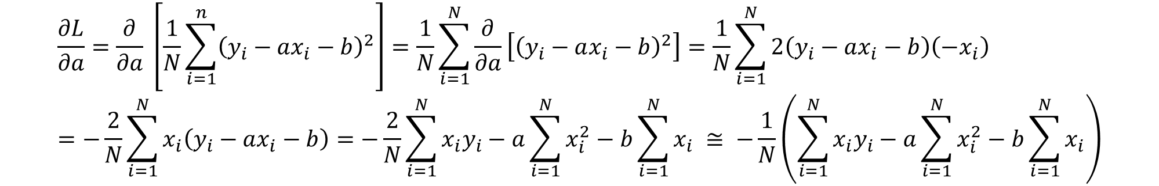

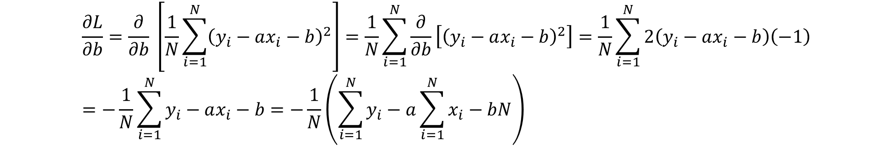
Partial Derivatives $\frac{∂L}{∂a}$ and $\frac{∂L}{∂b}$
$$\frac{∂L}{∂a}=\frac{∂}{∂a} \left[\frac{1}{N}\sum_{i=1}^{n}{{\left(y_{i}−ax_{i}−b\right)}^{2}}\right]=\frac{1}{N}\sum_{i=1}^{N}{\frac{∂}{∂a}\left[{\left(y_{i}−ax_{i}−b\right)}^{2}\right]}=\frac{1}{N}\sum_{i=1}^{N}{2\left(y_{i}−ax_{i}−b\right)\left(−x_{i}\right)}=−\frac{2}{N}\sum_{i=1}^{N}{x_{i}\left(y_{i}−ax_{i}−b\right)}=−\frac{2}{N}\sum_{i=1}^{N}{x_{i}y_{i}}−a\sum_{i=1}^{N}{x_{i}^{2}}−b\sum_{i=1}^{N}{x_{i}} ≅ −\frac{1}{N}\left(\sum_{i=1}^{N}{x_{i}y_{i}}−a\sum_{i=1}^{N}{x_{i}^{2}}−b\sum_{i=1}^{N}{x_{i}}\right)$$
$$\frac{∂L}{∂b}=\frac{∂}{∂b} \left[\frac{1}{N}\sum_{i=1}^{N}{{\left(y_{i}−ax_{i}−b\right)}^{2}}\right]=\frac{1}{N}\sum_{i=1}^{N}{\frac{∂}{∂b}\left[{\left(y_{i}−ax_{i}−b\right)}^{2}\right]}=\frac{1}{N}\sum_{i=1}^{N}{2\left(y_{i}−ax_{i}−b\right)\left(−1\right)}=−\frac{1}{N}\sum_{i=1}^{N}{y_{i}−ax_{i}−b}=−\frac{1}{N}\left(\sum_{i=1}^{N}{y_{i}}−a\sum_{i=1}^{N}{x_{i}}−bN\right)$$

Slide 29
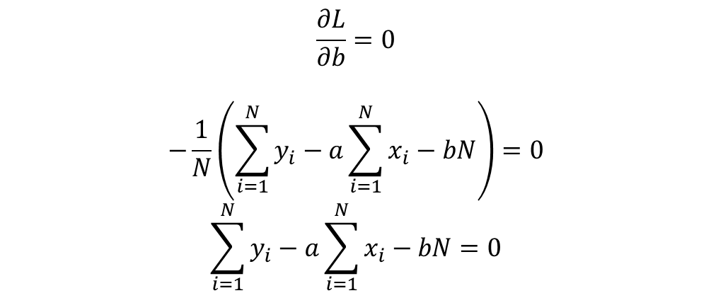
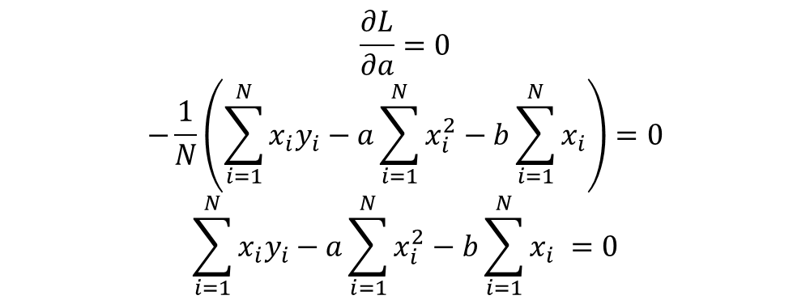
Let’s first use the partial derivatives to analytically fit the model to data
To analytically find the local minimum, we need to equate all the partial derivatives to 0 and solve for a and b
$$\frac{∂L}{∂a}=0$$
$$−\frac{1}{N}\left(\sum_{i=1}^{N}{x_{i}y_{i}}−a\sum_{i=1}^{N}{x_{i}^{2}}−b\sum_{i=1}^{N}{x_{i}}\right)=0$$
$$\sum_{i=1}^{N}{x_{i}y_{i}}−a\sum_{i=1}^{N}{x_{i}^{2}}−b\sum_{i=1}^{N}{x_{i}} =0$$
$$\frac{∂L}{∂b}=0$$
$$−\frac{1}{N}\left(\sum_{i=1}^{N}{y_{i}}−a\sum_{i=1}^{N}{x_{i}}−bN\right)=0$$
$$\sum_{i=1}^{N}{y_{i}}−a\sum_{i=1}^{N}{x_{i}}−bN=0$$

Slide 30
Code Along: Let’s implement the SLR with analytical approach

Slide 31
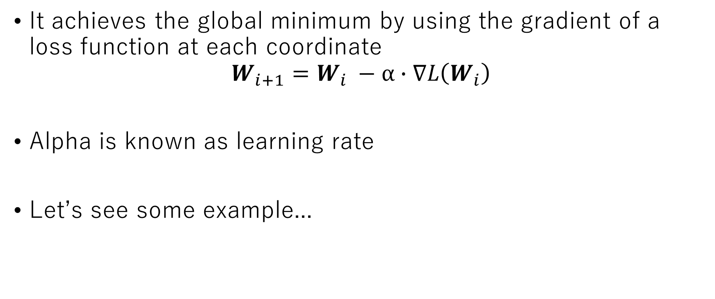
A famous iterative approach: Gradient Descent
It achieves the global minimum by using the gradient of a loss function at each coordinate
$$W_{i+1}=W_{i} −α∙∇L\left(W_{i}\right)$$
Alpha is known as learning rate
Let’s see some example...

Slide 32
Example: only one parameter

Slide 33
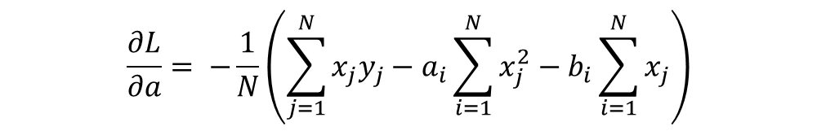


GD Equation for Our Model Fitting
$$w_{i+1}=w_{i} −α∙∇L\left(w_{i}\right)$$
$$=\left(\begin{matrix}a_{i} \\ b_{i}\end{matrix}\right)−α∙\left(\begin{matrix}\frac{∂L}{∂a} \\ \frac{∂L}{∂b}\end{matrix}\right)$$
$$\frac{∂L}{∂a}= −\frac{1}{N}\left(\sum_{j=1}^{N}{x_{j}y_{j}}−a_{i}\sum_{i=1}^{N}{x_{j}^{2}}−b_{i}\sum_{i=1}^{N}{x_{j}}\right)$$
Substitute into
$$\frac{∂L}{∂b}=−\frac{1}{N}\left(\sum_{j=1}^{N}{y_{j}}−a_{i}\sum_{j=1}^{N}{x_{j}}−b_{i}N\right)$$

Slide 34
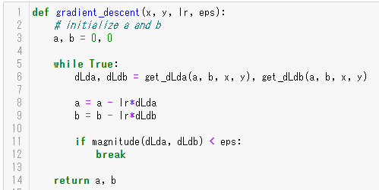
Code Along: Let’s implement it!

Slide 35
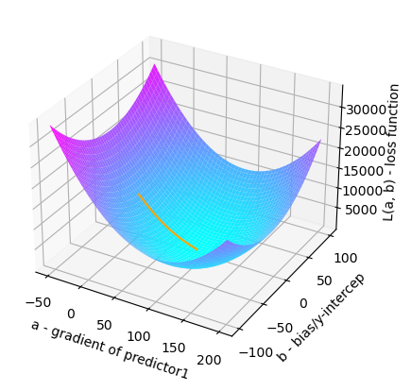
Visualizing the actual iterative learning process
Starting coordinate = (0, 0)
Ending coordinate = global min

Slide 36
Hyperparameters of GD
There are two hyperparameters (parameters that you need to determine by yourself by trial and error) in GD.
learning rate: it controls how quickly you want to move to get to the minima. Smaller this value is, slower the learning process is. In the above example, we choose 0.001.
the epsilon: It controls when to stop the iterative process of GD. It is defined by the magnitude of gradient. In the above example we chose it as 0.1.

Slide 37
Stochastic Gradient Descent

Slide 38
Advantage of using iterative approach/GD
At first glance, it might seem that using iterative approach doesn’t make sense because it seems slow (with all the updates)
However, in many cases, iterative approach is faster. This is because the analytical approach always require an inverse matrix.
If you’ve taken MAT1841, I think you have experience in calculating inverse matrix by hands and feeling it so annoying. Even with the fastest inverse matrix algorithm, it’s still O(n^3) to solve n*n matrix.
Also, the analytical approach requires O(n^2) space complexity, which is huge, especially when you have millions of data points.

Slide 39
Implementing the SLR as a Class

Slide 40
Multiple Linear Regression

Slide 41
Summary

Slide 42
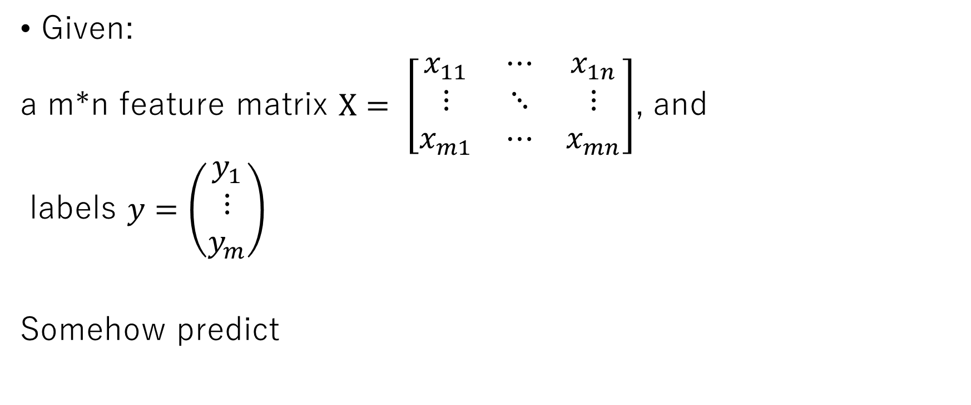
In formal term:
Given:
a m*n feature matrix $X= \left[\begin{matrix}x_{11} & ⋯ & x_{1n} \\ ⋮ & ⋱ & ⋮ \\ x_{m1} & ⋯ & x_{mn}\end{matrix}\right]$, and
labels $y=\left(\begin{matrix}y_{1} \\ ⋮ \\ y_{m}\end{matrix}\right)$
Somehow predict

Slide 43
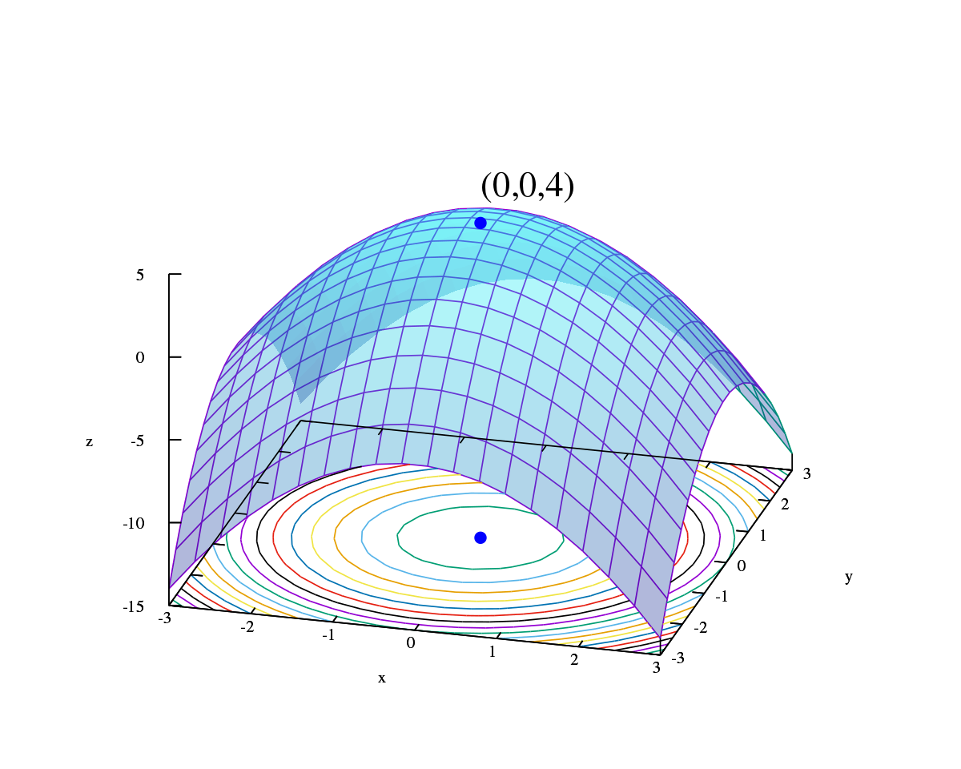
What is mathematical optimization?
Argmin/argmax/max/min
In ML, in many cases it deals with a brunch of mathematical optimization called convex optimization. cone-like functions (Convex functions)

